Slide 1
Calendar Scheduling and Alarm System in Python AND C
A Comprehensive Event Scheduling and Reminder Application with GUI
by: saicharan a s

Slide 2
Introduction
Purpose: This project focuses on developing a Python-based calendar scheduling and alarm system. It allows users to manage events, set notifications, and handle recurring tasks.
Objectives:
• Implement an intuitive graphical user interface (GUI) for event management.
• Provide desktop notifications when events are due.
• Enable daily, weekly, and monthly recurring events.
• Search events by title or date.

Slide 3


Project Requirements
Software Requirements:
• Python 3.x
• tkinter for GUI
• plyer for notifications
• datetime for handling dates and times
• json for data storage
Hardware Requirements:
• Standard computer system with Python installed.

Slide 4

Problem Statement
Problem:
• Manual scheduling can be time-consuming and error-prone.
• Users often forget important events without reminders.
• Need for a simple solution that can handle recurring events efficiently.
Solution:
A Python-based scheduling system that automates event management and reminds users of upcoming tasks through desktop notifications.

Slide 5
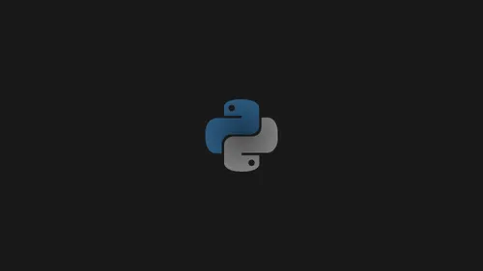

System Architecture
A flowchart illustrating the system:
1. Event Creation - GUI input
2. Data Storage - JSON file to save events
3. Alarm Checker - Continuously checks current time
4. Desktop Notification - Triggers if the time matches

Slide 6
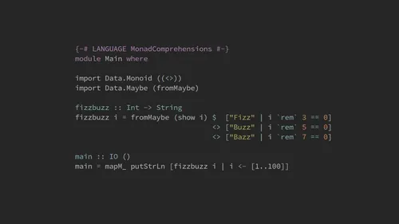
Project Features
• Event Scheduling: Add, edit, and delete events with ease.
• Desktop Notifications: Timely notifications for upcoming events.
• Recurring Events: Manage events that repeat daily, weekly, or monthly.
• Search Functionality: Search for specific events by title or date.

Slide 7
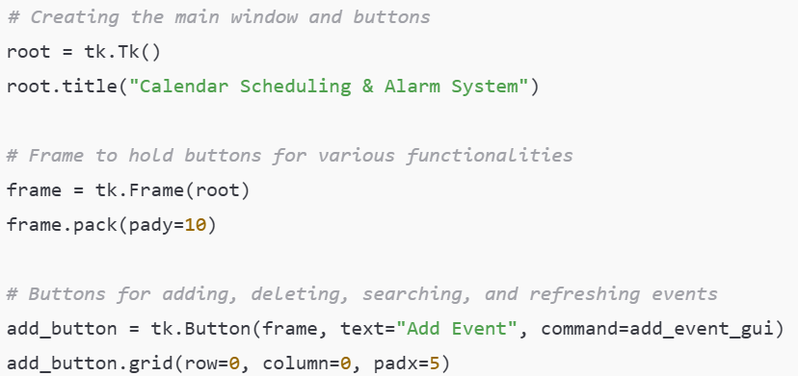
Implementation - Code Overview
User Interface (tkinter):

Slide 8
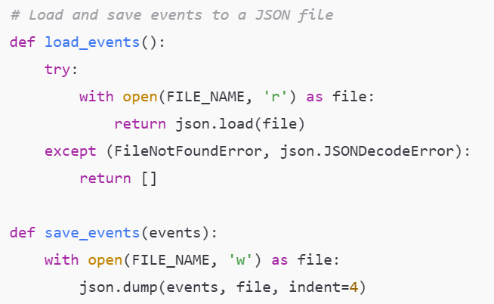
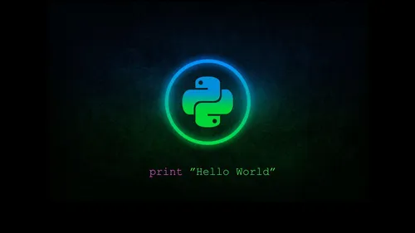
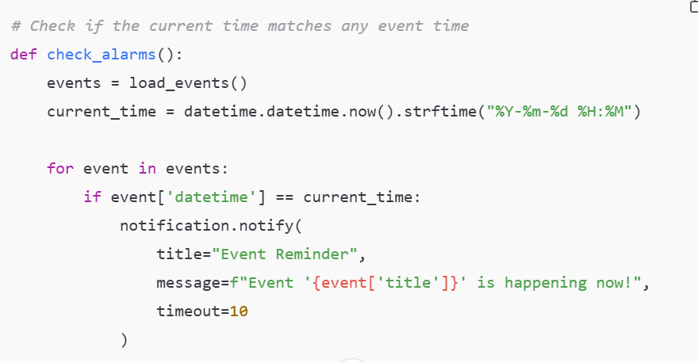
Data Handling ( JSON )
Alarm Trigger (date & time)

Slide 9
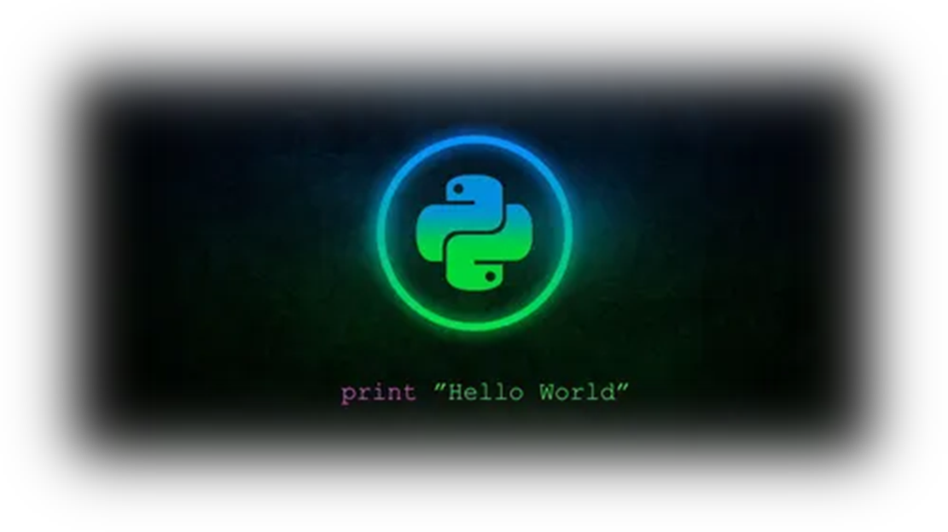
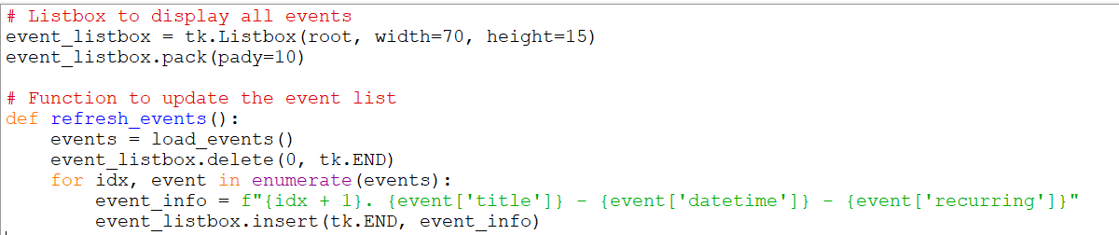
Graphical User Interface (GUI)
The GUI is built using tkinter to create a user-friendly interface.
Key features include:
• A main window with buttons to add, delete, search, and refresh events.
• A listbox displaying scheduled events.

Slide 10
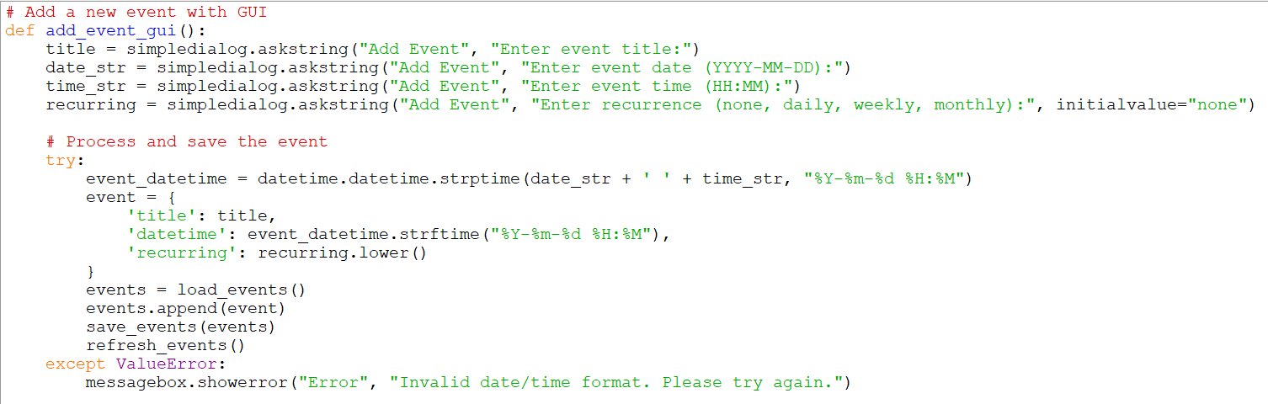
Event Scheduling and Notifications
Users can add events by specifying the title, date, time, and recurrence pattern. Notifications pop up at the event time using plyer.

Slide 11

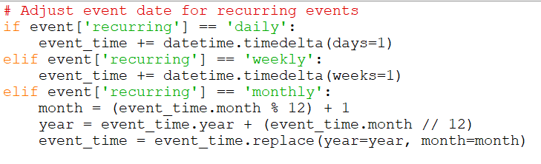
Recurring Events Handling
Users can select a recurrence pattern (daily, weekly, monthly). The system automatically adjusts the date for the next event when triggered.

Slide 12
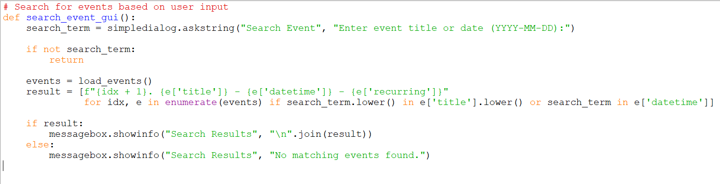
Search Functionality
Users can search for events by entering a title or date. The search results are displayed in a popup

Slide 13

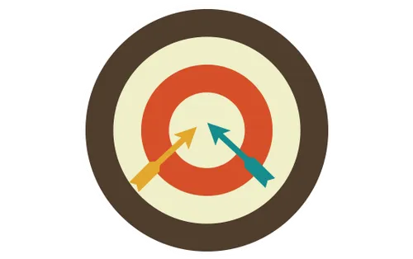
Challenges Faced
• Time Management: Ensuring the alarm system efficiently handles multiple events.
• Date and Time Handling: Parsing and comparing date/time values without errors.
• Recurring Events Complexity: Properly adjusting dates for recurring events.

Slide 14
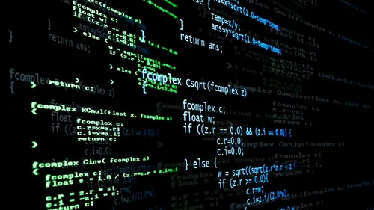
Future Improvements
• Enhanced Recurrence: Add support for custom intervals (like bi-weekly).
• Sound Notifications: Integrate sounds with desktop notifications.
• Database Integration: Shift from JSON to SQLite for better data management.

Slide 15
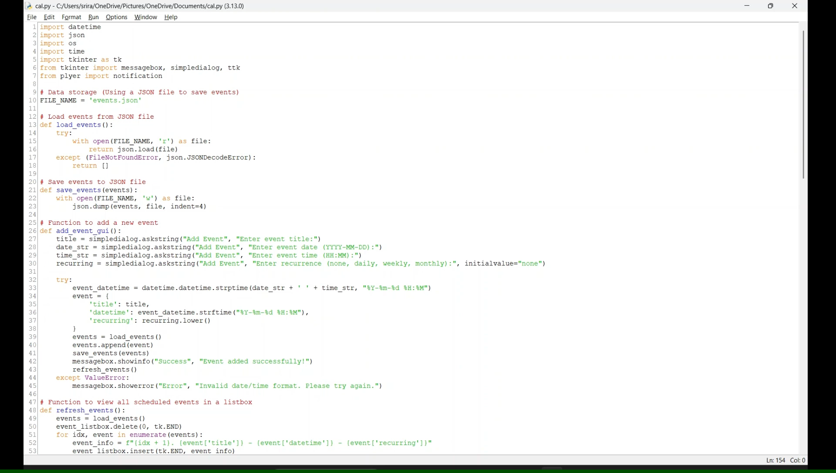
Demonstration

Slide 16
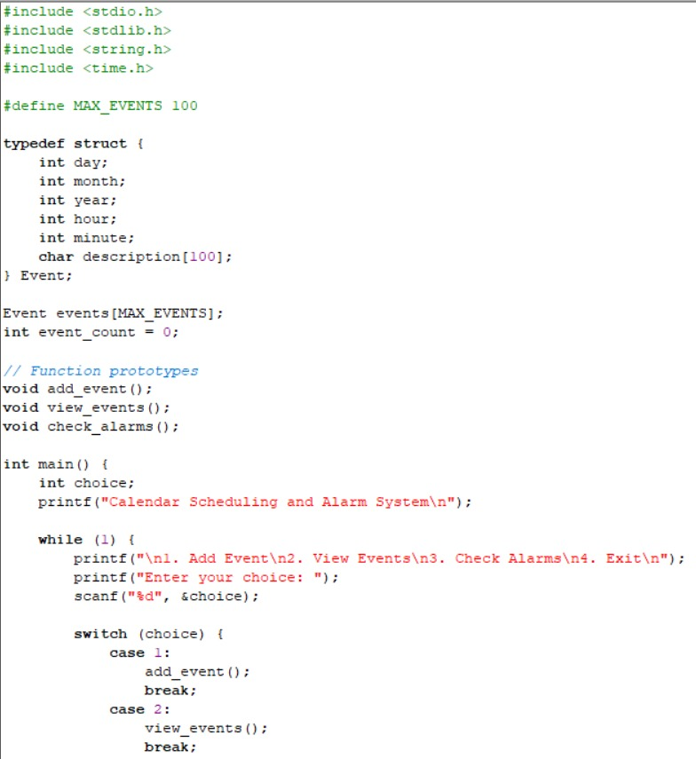
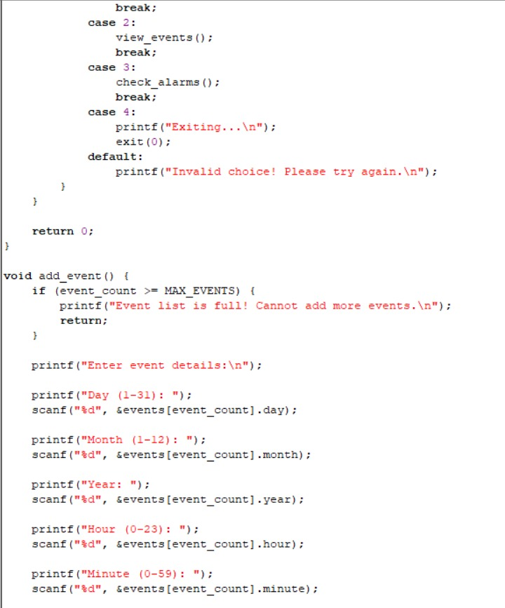
PROGRAM IN C

Slide 17
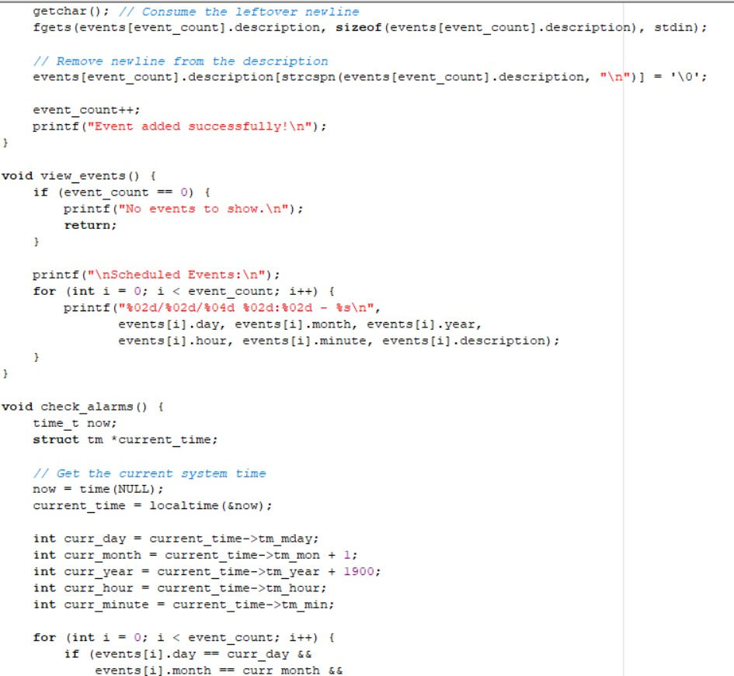
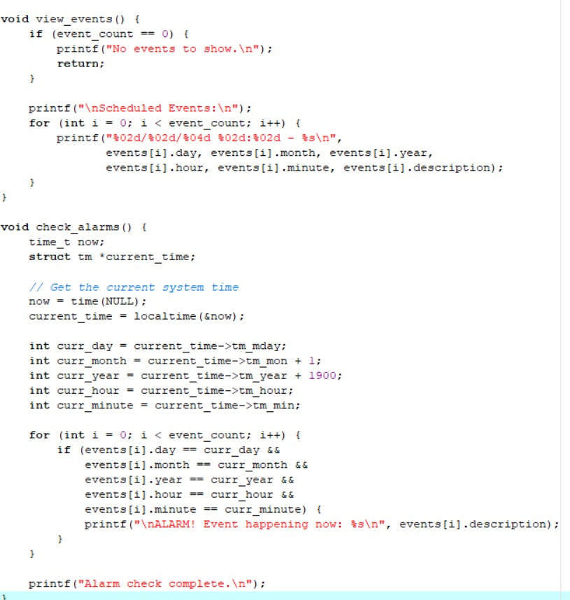

Slide 18
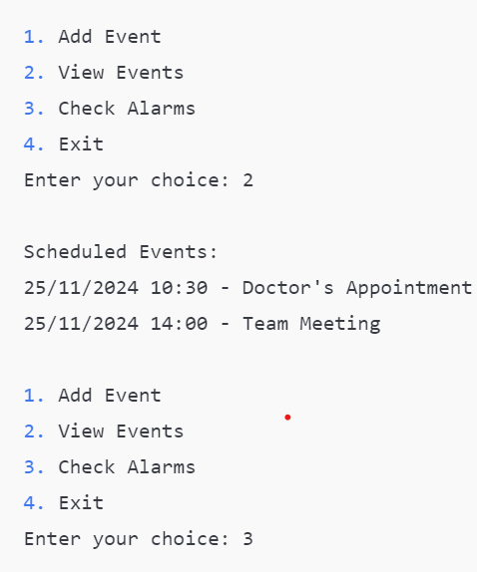
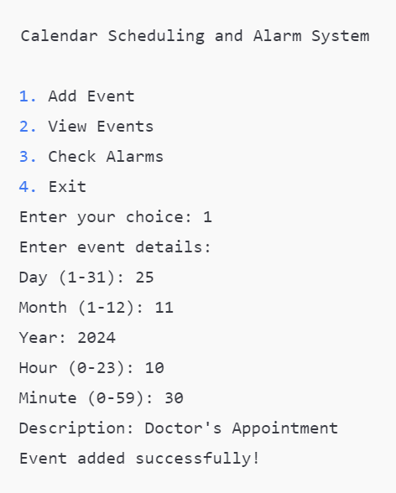
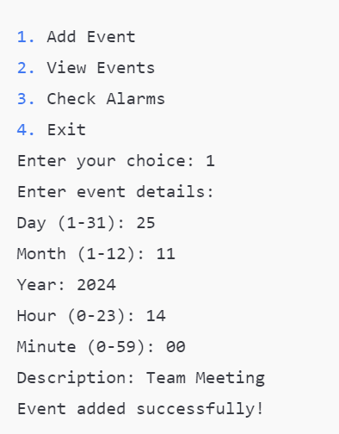
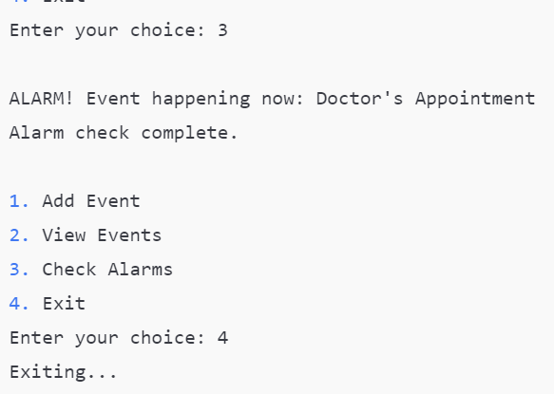
OUTPUT

Slide 19
Comparison between python and c
The C code implements a basic calendar and alarm system using a command-line interface. Users can add events, view them, and check for alarms based on the current time. The events are stored in an in-memory array, meaning they are lost when the program exits. It lacks support for recurring events and persistent storage. The Python code, in contrast, features a graphical user interface (GUI) built with tkinter and provides a more user-friendly experience. Events are stored in a JSON file, ensuring persistence between program runs. The Python system supports adding, deleting, and searching events, as well as handling recurring events (daily, weekly, monthly). It also uses plyer for desktop notifications to alert users when an event occurs. The Python code provides more advanced functionality, including recurring events, persistent storage, and automated alarm checks, while the C code is simpler, with a text-based interface and limited features.

Slide 20
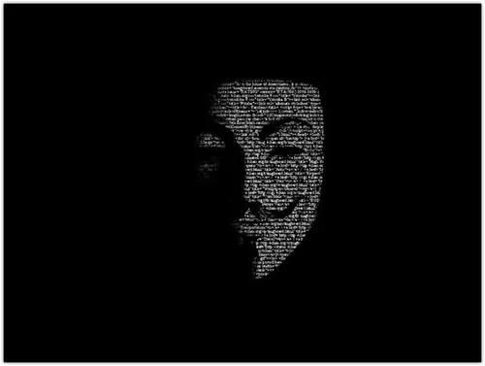
Conclusion
Summary:
• Successfully developed a Python application for event scheduling and reminders.
• Implemented GUI, notifications, recurring events, and search functionality.
• Learning Experience: Insights on time management, GUI design, and data handling.

Slide 21

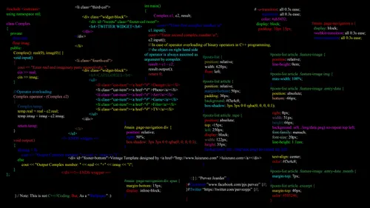
References
1. Python Documentation (https://docs.python.org)
2. tkinter Documentation (https://docs.python.org/3/library/tkinter.html)
3. plyer Documentation (https://plyer.readthedocs.io)
4. JSON Handling in Python (https://docs.python.org/3/library/json.html)
5. Stack Overflow - Community Q&A (https://stackoverflow.com)
Project URL : https://github.com/sriramks06/Python-Project-PPS-.git

Slide 22
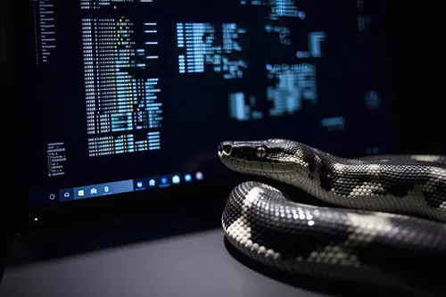
Thank You

